Slide 1
Geographies of crowdsourced information and their implications
School of Geography, Geology and the Environment
Andrea Ballatore
Department of Geography,
Birkbeck, University of London
Stefano De Sabbata*
School of Geography, Geology and the Env.,
University of Leicester
AGILE 2018 – Lund, Sweden

Slide 2
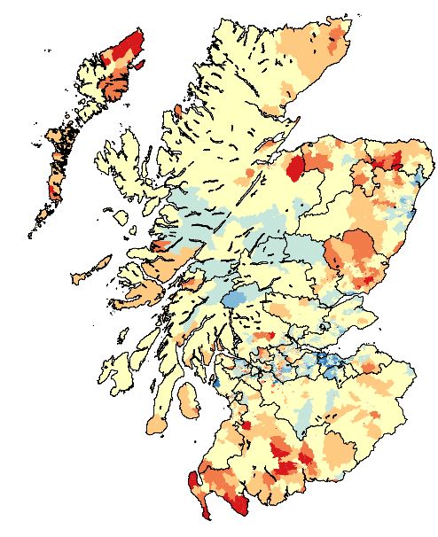
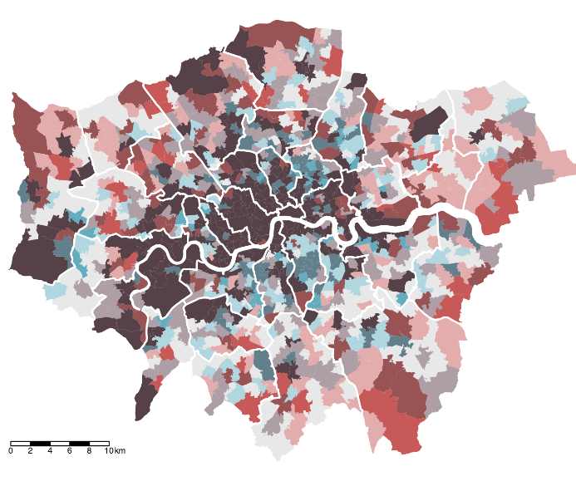
Case studies
Operationalising quality in health studies
with J Bright, S Lee, B Ganesh, DK Humphreys
OpenStreetMap
impact of availability on alcohol-related harm
Analysis of global gazetteers
with E Acheson and RS Purves
GeoNames and Getty TGN
patterns of coverage
Urban Information Geographies
with A Ballatore
with N Tate
quality and representativeness of VGI
Notes:
Patterns in the data analyzed or in the data used for the analysis?

Slide 3
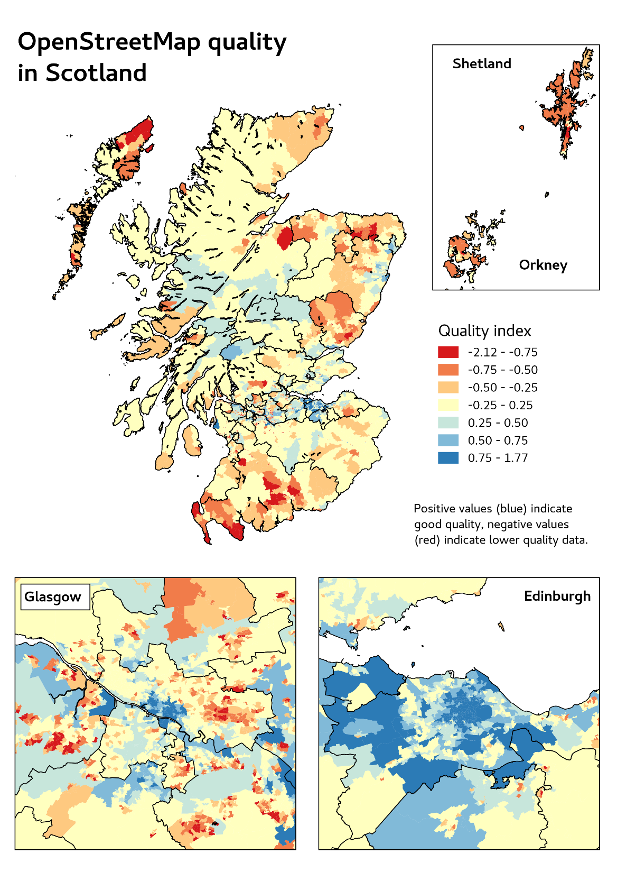
Operationalising VGI in health studies
with J Bright, S Lee, B Ganesh, DK Humphreys
OpenStreetMap
impact of availability on alcohol-related harm
Notes:
Link between physical availability of alcohol and harm is supported by a growing body of international research
Statistical association between the spatial availability of alcohol (i.e. alcohol outlet density) and the prevalence of a range of acute and chronic physical and social harms
Small number of geographic contexts, such as the United States, Canada, Australia and Scandinavia.
UK have been underrepresented in this literature
Authors underlined the challenges of using administrative licensing records to generate spatial measures of alcohol availability
Significant barriers preventing researchers and practitioners from easily monitoring and evaluating the impact of policy interventions

Slide 4
Quality indicator
Intrinsic quality indicator based on Barron et al. (2014)
Calculated as a linear combination of:
Values | Transformation
Num. of map features per square kilometre | Log transformed, scaled
Average num. of edits per map feature | Log transformed, scaled
Num. of users who made at least one edit | Log transformed, scaled
Num. of features edited by more than one user | Log transformed, scaled
Num. of days with at least one edit | Log transformed, scaled
Days since the last edit in the area | Inversed, scaled
Proportion of buildings with full address | -1 if 0%, 0 if no buildings

Slide 5
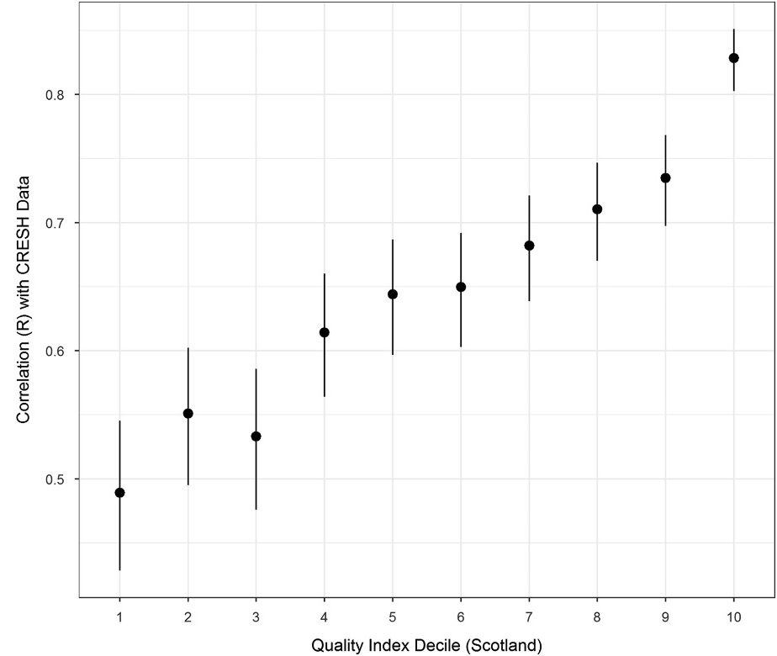
Replicating CRESH study
The overall conclusions are essentially identical
significant positive correlation between density of alcohol outlets and incidence of alcohol related harms
an effect size which is comparable (though smaller)
The correlation between OSM-based estimates and CRESH is stronger where the quality index is higher

Slide 6
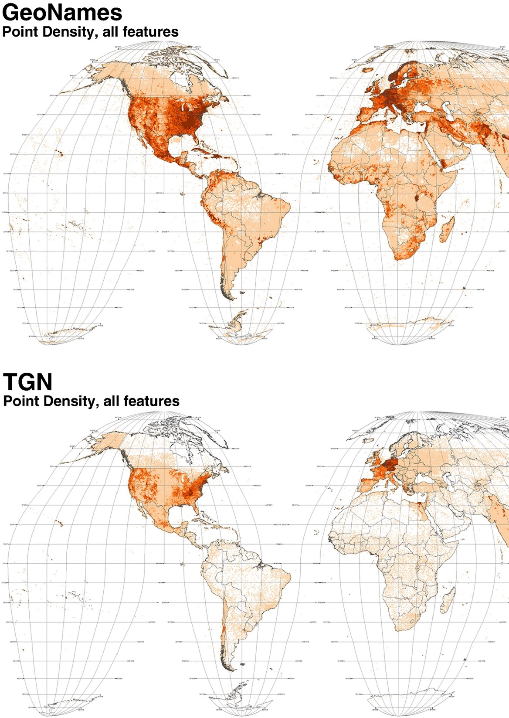
Analysis of global gazetteers
with E Acheson and RS Purves
GeoNames and Getty TGN
patterns of coverage

Slide 7
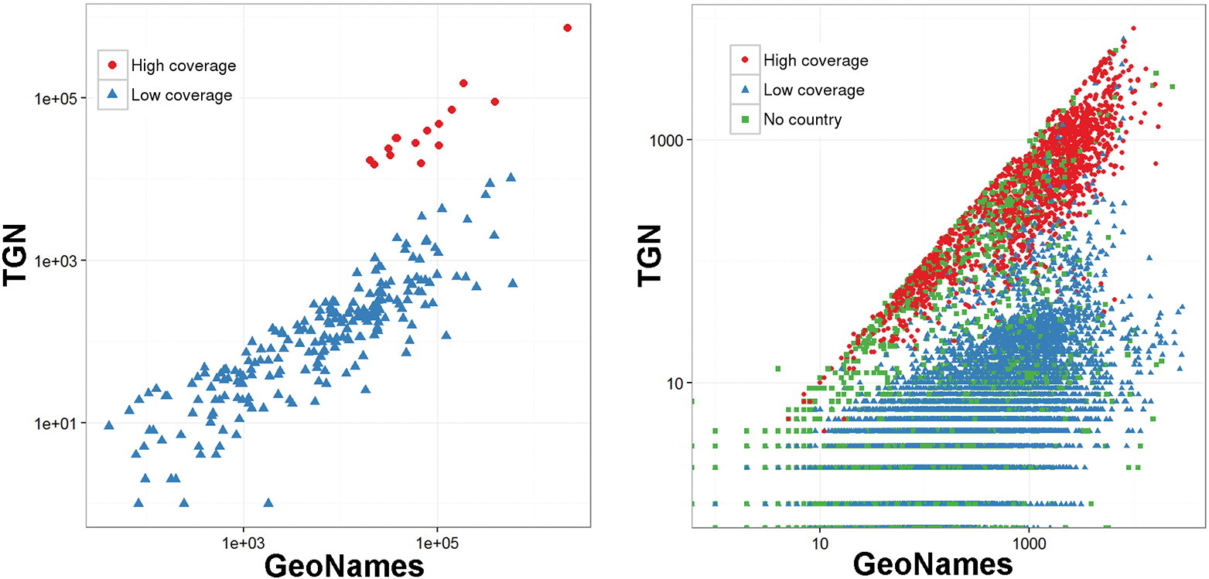
Comparing GeoNames and TGN
Two distinct levels of coverages
in “high coverage” countries, TGN same order of magnitude as counts in GeoNames
in “low coverage” countries, GeoNames has over 60 times as much content as TGN
Notes:
an increase of 100 features in GeoNames corresponds to an increase of only 71 features in TGN

Slide 8
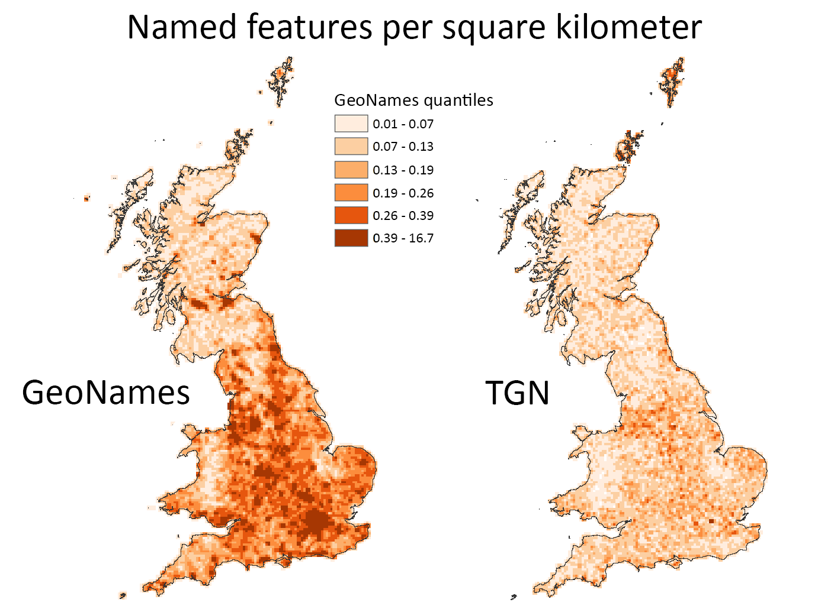
GeoNames and TGN in Great Britain
Gazetteer | Features | Pop place
GeoNames | 54,701 | 16,475
Getty TGN | 24,003 | 16,816
Ordnance Survey 50k | 248,626
Ordnance Survey OpenNames |  | 41,490

Slide 9
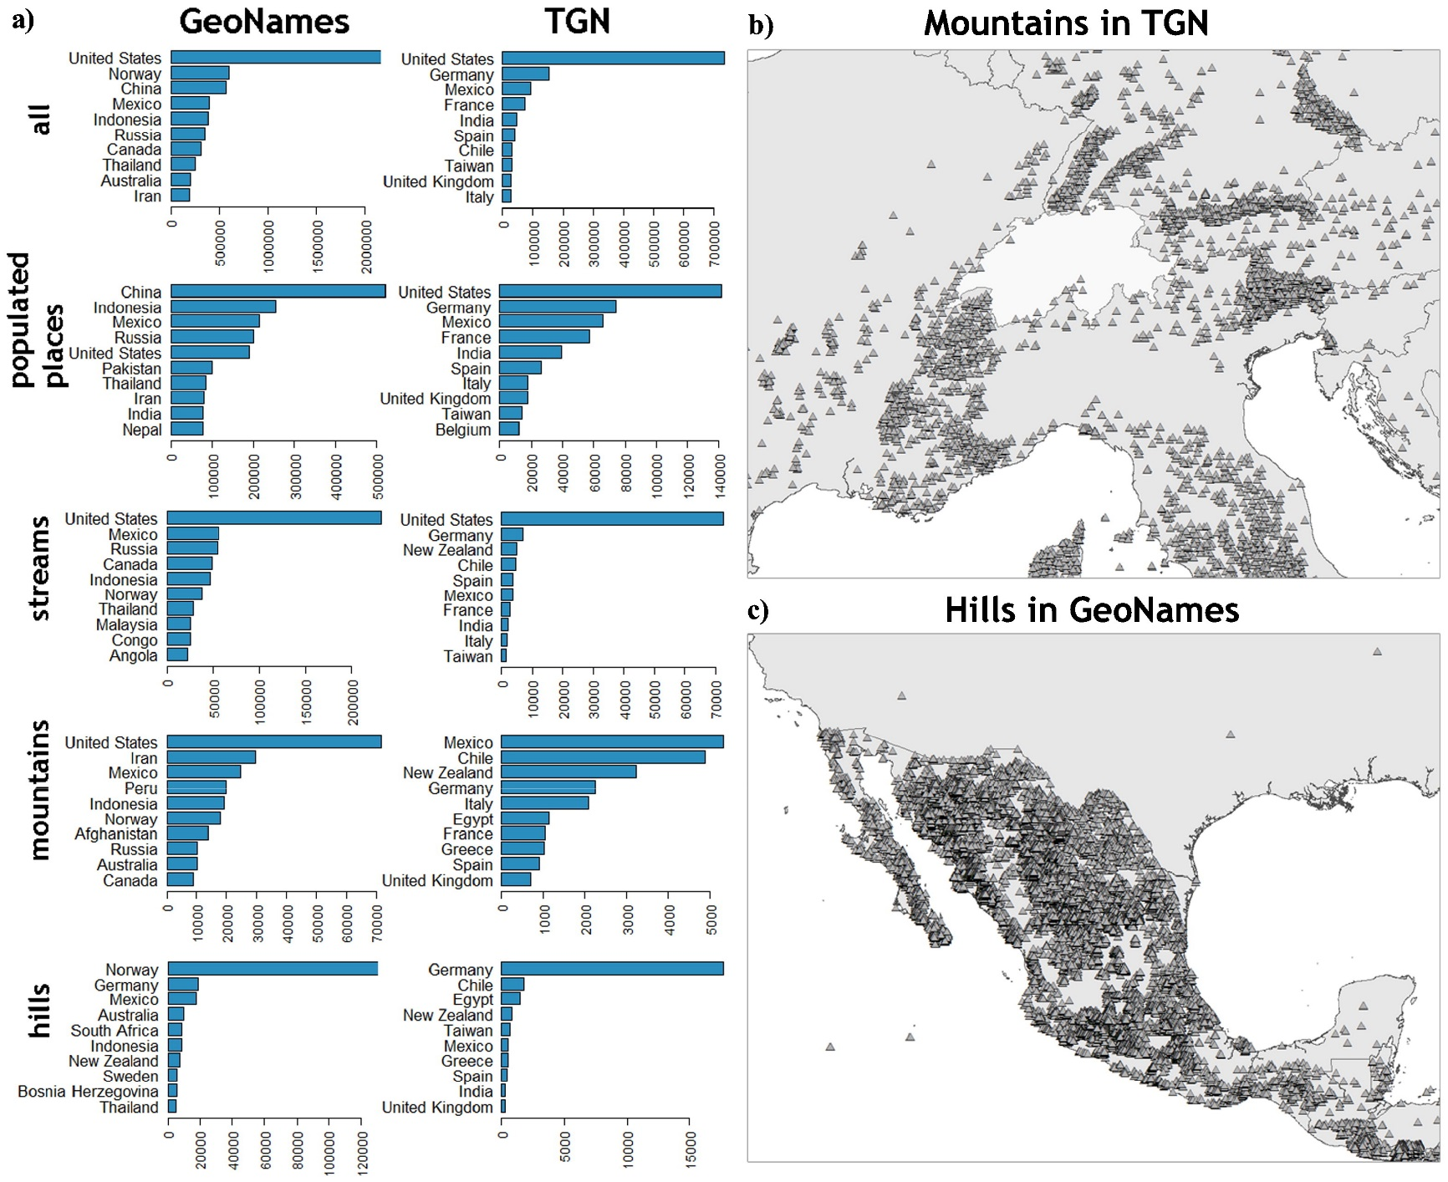
Feature types

Slide 10
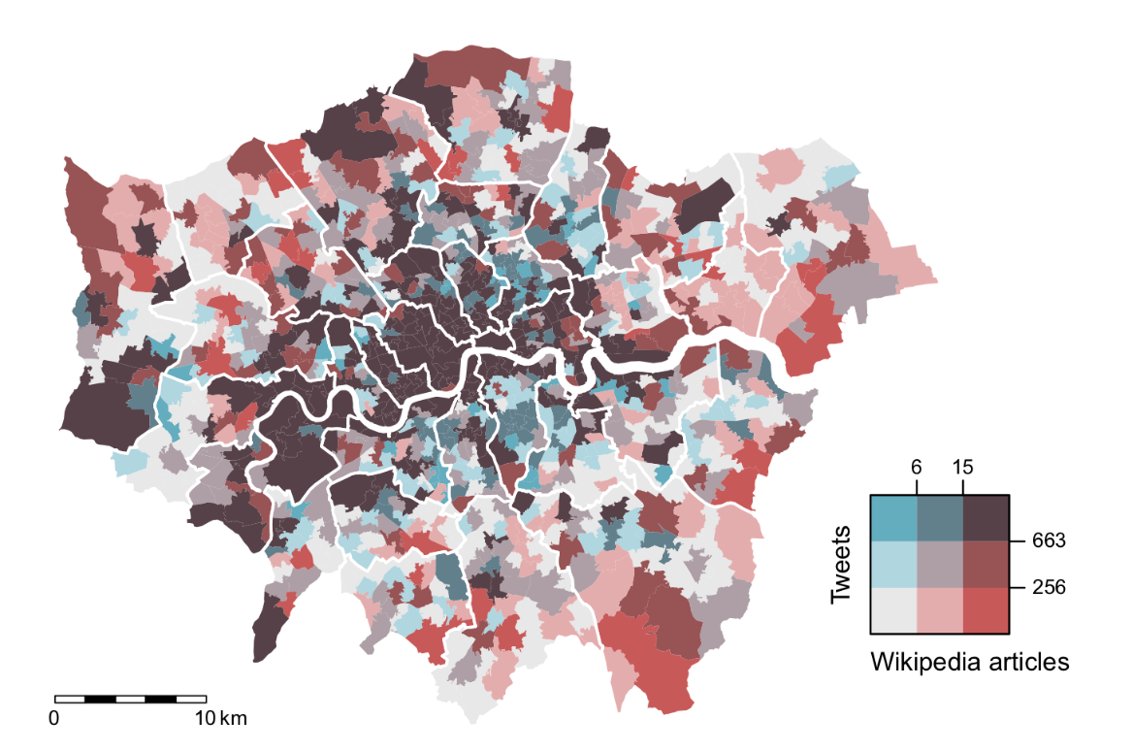
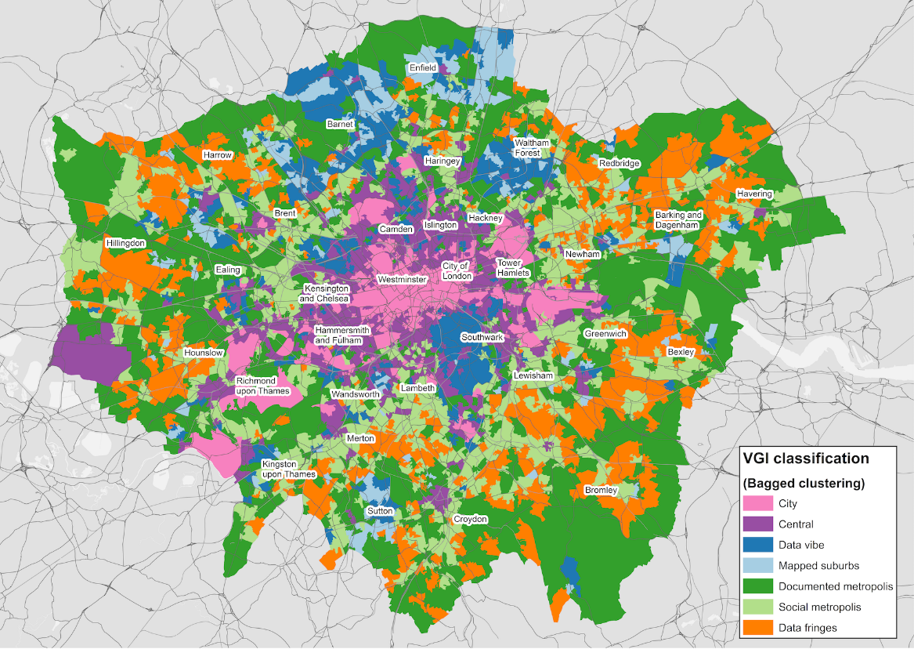
Urban Information Geographies
with A Ballatore
with N Tate
quality and representativeness of VGI

Slide 11
Overview
Aim: understanding the Urban Information Geographies of crowdsourcing platforms, and their possible implications for their users and services using those data.
Research Questions
Which areas a over- and under-represented in Twitter and Wikipedia in Greater London?
How do Twitter and Wikipedia compare in Greater London?
Underlying hypothesis:
representation biases
wealthier
younger
higher qualification

Slide 12
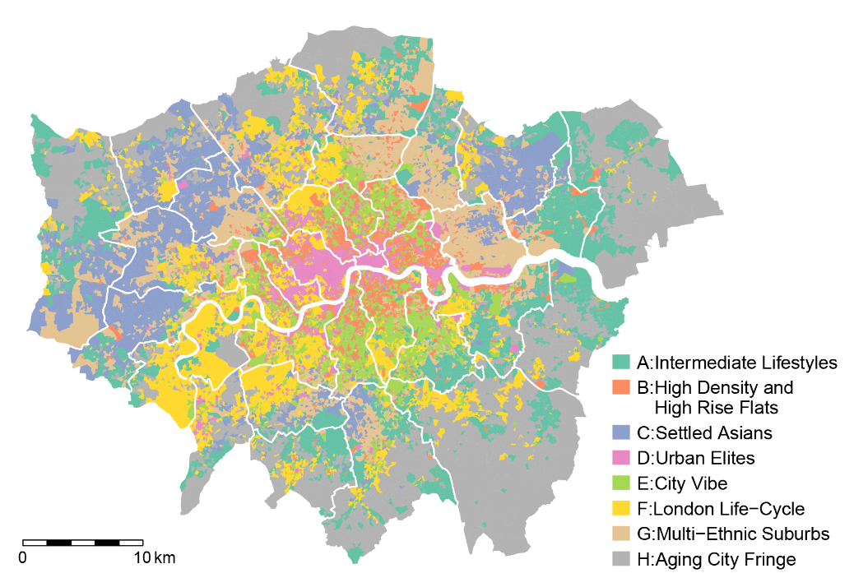

Notes:
Darkest = data-richest areas.
Correspond with OAs classified as “Urban Elites” (i.e., young professionals in science, technology, and finance)
and “London Life-Cycle”(i.e., relatively low numbers of students and households with dependent children, highly qualified professionals, predominantly white)
City and Westminster, as well as Richmond, Merton, and the south part of Newham.
Wikipedia, cultural heritage
Heathrow Airport
Many areas in Southwark and Hackney, classified as “City Vibe” (single professionals and students in communal establishments)
high Twitter, low Wikipedia content.
socio-demographic characteristics + relatively low density of notable urban features in those districts
Low-tweet areas seem to align with OAs classified as “Intermediate Lifestyles” and “Aging City Fringe”, both associated with households in later stages in life-cycle.
both Twitter and Wikipedia tends to be representative of wealthier areas, inhabited by younger sections of the population, with access to higher levels of qualifications.

Slide 13
Findings
Overall confirmed (some) hypothesis
representation similar biases as participation
Higher qualifications strongest factor
Wealth (house prices) strong factor in both, more so for Wikipedia
Twitter strongly influenced by perc. of ppl. aged 30-44 (positively) and households with de-pendent children (negatively)
However
models account only for about 44–55% of variability
need for more explanatory factors, e.g., tourism-related activities
…or can these difference be used as indicators?
ethnic composition is not a factor in the UK
Twitter and Wikipedia similar but distinct geographies
only representative of themselves

Slide 14
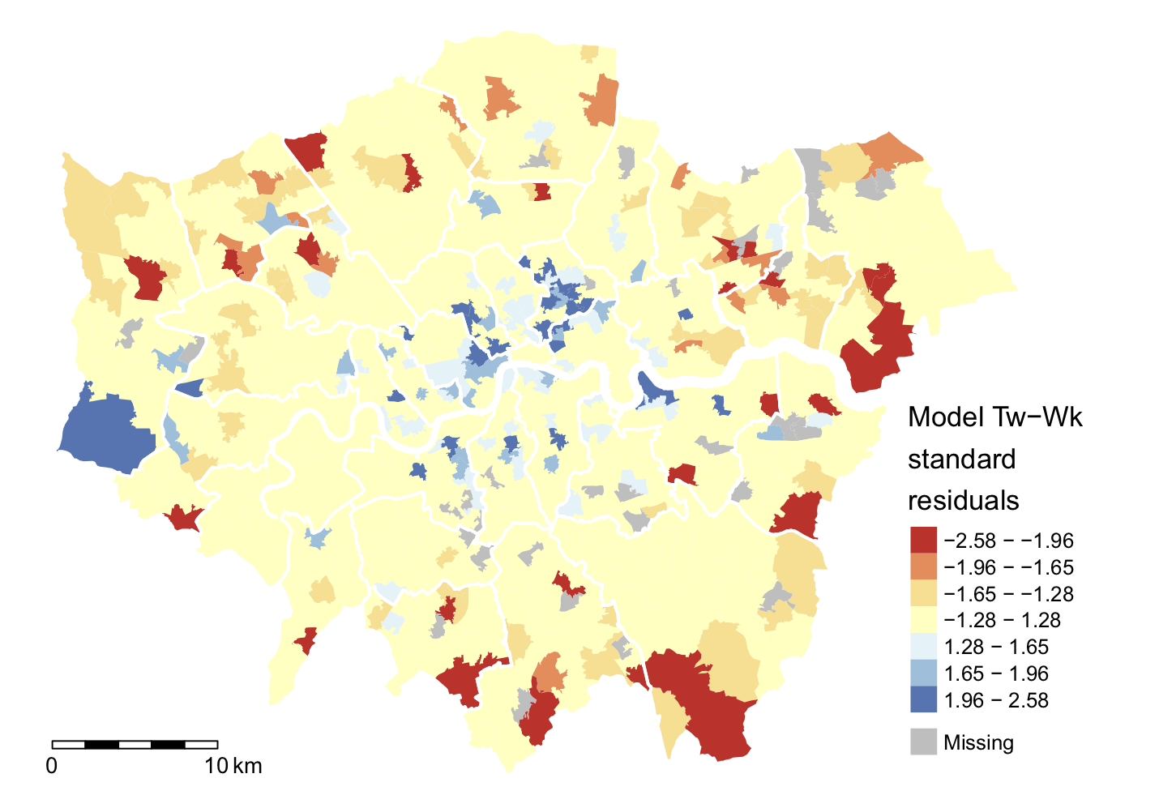
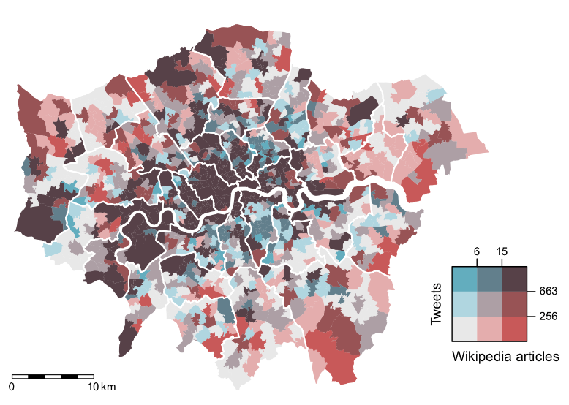
Comparing Twitter and Wikipedia
Number of tweets
(951 obs.)
~ Number of articles
Adj. R² = 0.490
Notes:
Based on Model Tw-Wk, other things being equal, a ten percent increase in thenumber of Wikipedia articles is linked to an increase in the number of tweets pro-duced in the MSOA of about 8%.
Unlike the previous models, this map shows some clustering in CentralLondon and Heathrow Airport, where Twitter activity is higher than expected basedon Wikipedia content, whilst the outskirts exhibit lower tweet density.
res = obs – model
Positive residuals (blue) underestimation
Negative residuals (red) overestimation

Slide 15
A geodemographic approach
Aims:
understanding Urban Information Geographies
moving from quality to representativeness
moving from single- to multi-platform perspective
Approach
creating a classification similar to the geodemographic classification based on census data
Flickr, OpenStreetMap, Twitter, Wikipedia
… work in progress
Notes:
Based on Model Tw-Wk, other things being equal, a ten percent increase in thenumber of Wikipedia articles is linked to an increase in the number of tweets pro-duced in the MSOA of about 8%.
Unlike the previous models, this map shows some clustering in CentralLondon and Heathrow Airport, where Twitter activity is higher than expected basedon Wikipedia content, whilst the outskirts exhibit lower tweet density.
res = obs – model
Positive residuals (blue) underestimation
Negative residuals (red) overestimation

Slide 16

Notes:
Based on Model Tw-Wk, other things being equal, a ten percent increase in thenumber of Wikipedia articles is linked to an increase in the number of tweets pro-duced in the MSOA of about 8%.
Unlike the previous models, this map shows some clustering in CentralLondon and Heathrow Airport, where Twitter activity is higher than expected basedon Wikipedia content, whilst the outskirts exhibit lower tweet density.
res = obs – model
Positive residuals (blue) underestimation
Negative residuals (red) overestimation

Slide 17
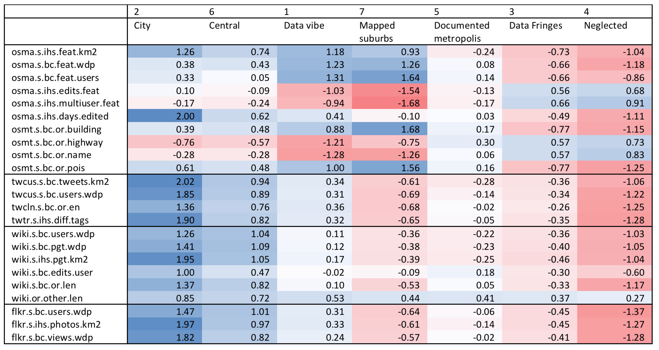
Classification
Notes:
In order to identify the optimal number of clusters, a common WCSS analysis was conducted, simulating the clustering process 10,000 times for each number of clusters between 2 and 15. Through this process, we identified 4 and 7 as the preferable choices for the number of clusters. Both options were explored, as a low number of clusters as 4 would provide us with a general overview of the values distributions, whereas an higher number of clusters as 7 would allow a more detailed analysis.
In order to further test the robustness of our approach, we applied the “bagged clustering” algorithm has been applied to the same 22 variables used in the previous step. The resulting dendrogram is presented in Fig. 7. Consistently with the previous analysis based on k-means, we identified the values 4 and 7 were identified as preferable choice for the number of clusters.
After consideration of the results of the clustering procedure, the classification produced through bagged clustering is preferred to the classification produced through kmeans . The motivation is twofold. First, while the two classifications are generally similar (which also confirm the robustness of the approach), bagged clustering has been developed to overcome some of the limitations of kmeans, and it is thus assumed to produce (in general) better results. Second, the classification produced through bagged clustering highlights a distinction within a group of LSOAs which are aggregated in a single class by kmeans, which is of interest in our investigation of VGI production and representativeness.
There is confusion here between k-means (i.e. the techniques) and kmeans (i.e. the R function). Which is it? I suggest the former…
This seems a very short section?

Slide 18









Conclusions
More interaction between research on CGI core and domain applications
beyond technology, towards social domains
beyond the usual suspects (OSM, etc)
Access to data: sampling and scraping
Systematic work on limitations is needed
Urban Information Geographies
Impact of GDPR on access and use of data

Slide 19
Thank you for your attention. Any questions?
Andrea Ballatore
Department of Geography,
Birkbeck, University of London
Stefano De Sabbata
School of Geography, Geology and the Env.,
University of Leicester

Slide 20

Urban Information Geographies
Crowdsourced information is widely used in a variety of fields and for a variety of purposes
Participation biases are known, but broadly
Need to move research forward, towards a detailed, continuous analysis of the diverse picture created by a multiplicity of platforms
github.com/sdesabbata/
Urban Information Geographies

Slide 21
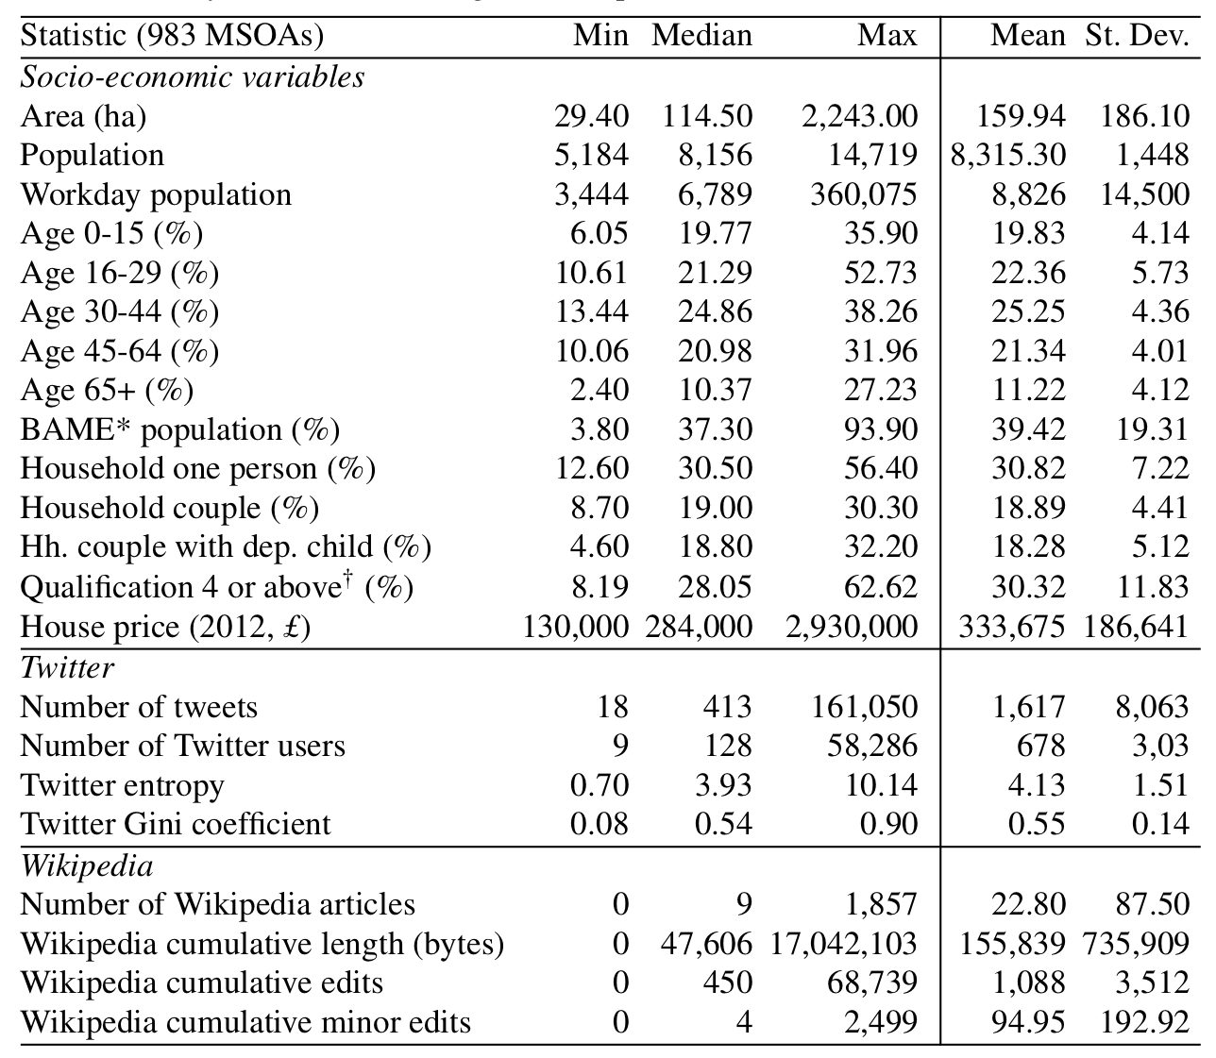
Descriptive statistics

Slide 22
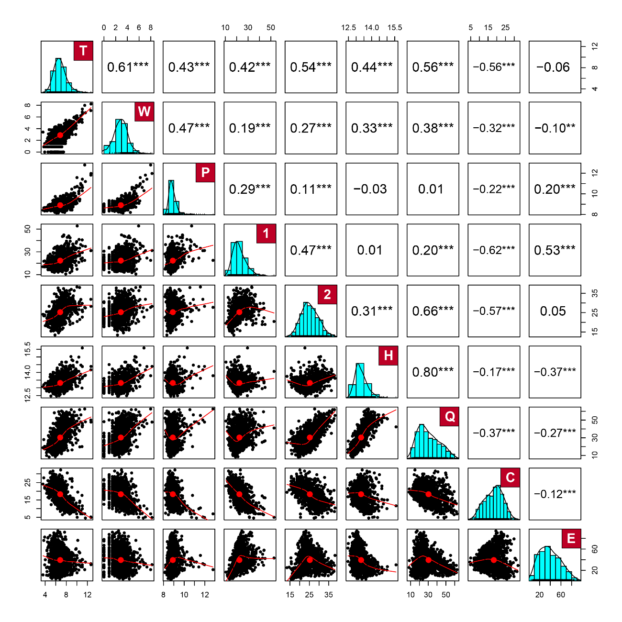
Descriptive statistics
Distribution and correlations between:
tweets[ihs](T),
Wikipedia articles[ihs](W),
work-day population[log](P),
percentage of population aged between 16 and 29 (1), and between 30and 44 (2), level four qualifications or above (Q), couples with dependent children (C), minor-ity groups (E), and house prices[ihs](H), in 983 MSOAs in Greater London. Significance level:∗p<0.1; ∗∗p<0.05; ∗∗∗p<0.01.

Slide 23
Linear models: Twitter

Slide 24
Linear models: Twitter
Model Tw1
residuals are not normally distributed (Shapiro-Wilk test, W=0.99,p<0.001)
Model Tw2
excluding all MSOAs having an average of 10 or more tweets per day
residuals are normally distributed (W=1,p=0.808)
residuals satisfythe homoscedasticity assumption (Breusch-Pagan test,BP=1.56,p=0.668)
errors slightly positively correlated, but this does not raise concerns (Durbin-Watson test,DW=1.65,p<0.001)
no multicollinearity (average VIF is 1.07)
Notes:
Testing independence of errors using Durbin-Watson test (should be close to 2, and not significant).

Slide 25
Linear models: Twitter
Model Tw3
residuals are not normally distributed (Shapiro-Wilk test, W=0.99,p<0.001)
Model Tw4
excluding all MSOAs having an average of 10 or more tweets per day
residuals are normally distributed (W=1,p=0.471)
residuals satisfy the homoscedasticity assumption (Breusch-Pagan test,BP=9.27,p=0.026)
errors are slightly positively correlated, but this is not a cause for concern (Durbin-Watson test,DW=1.74,p<0.001)
no multicollinearity has been identified (average VIF is 1.12)
Notes:
Testing independence of errors using Durbin-Watson test (should be close to 2, and not significant).

Slide 26
Linear models: Wikipedia

Slide 27
Linear models: Wikipedia
Model Wk1
residuals are normally distributed (Shapiro-Wilk test,W=1,p=0.219)
residual satisfy the homoscedasticity assumption (Breusch-Pagan test,BP=5.05,p=0.168)
errors are independent (Durbin-Watson test,DW=1.89,p=0.088)
no multi-collinearity has been identified (average VIF is 1.08)
Model Wk2
residuals are normally-distributed (W=1,p=0.158)
residuals satisfy the homoscedasticity assumption (BP=3.52,p=0.318)
errors appear to be independent (DW=1.86,p=0.04)
no multicollinearity has been identified (average VIF is 1.21)
Notes:
Testing independence of errors using Durbin-Watson test (should be close to 2, and not significant).

Slide 28
Linear models: Twitter and Wikipedia

Slide 29
Linear models: Twitter and Wikipedia
Model TwWk
residuals normally are distributed (Shapiro-Wilk test,W=1,p=0.649)
residuals satisfy the homoscedasticity assumption (Breusch-Pagan test,BP=4.7,p=0.03)
errors appear to be slightly positively correlated, but this is not a cause for concern (Durbin-Watson test,DW=1.34,p<0.001).
Notes:
Testing independence of errors using Durbin-Watson test (should be close to 2, and not significant).

Slide 30
Linear models: beta estimates

Slide 31
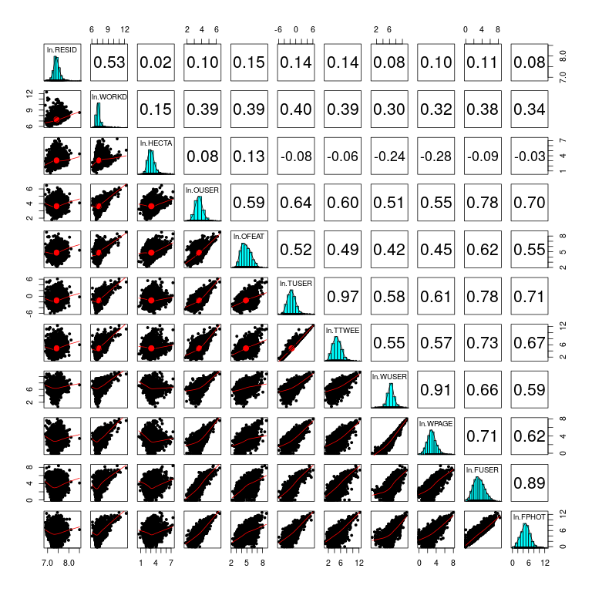
Variables geodemogr. classification

Slide 32
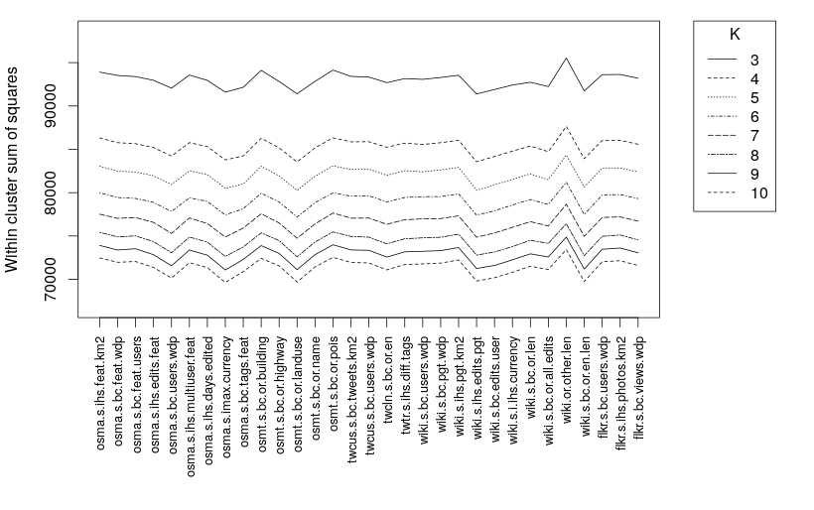
Classification procedure

Slide 33
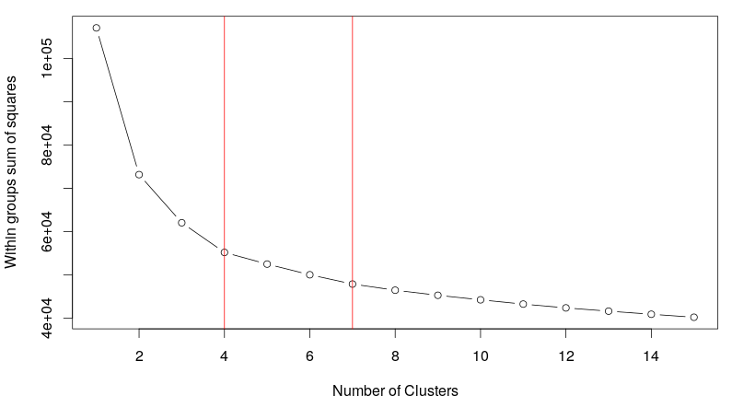
Classification procedure

Slide 34
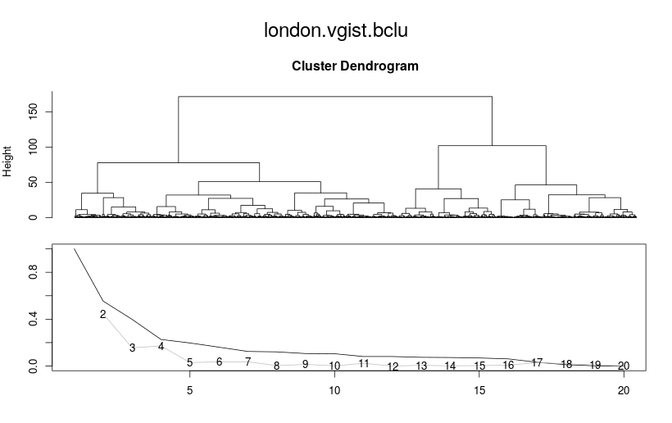
Bagged clustering

Slide 35
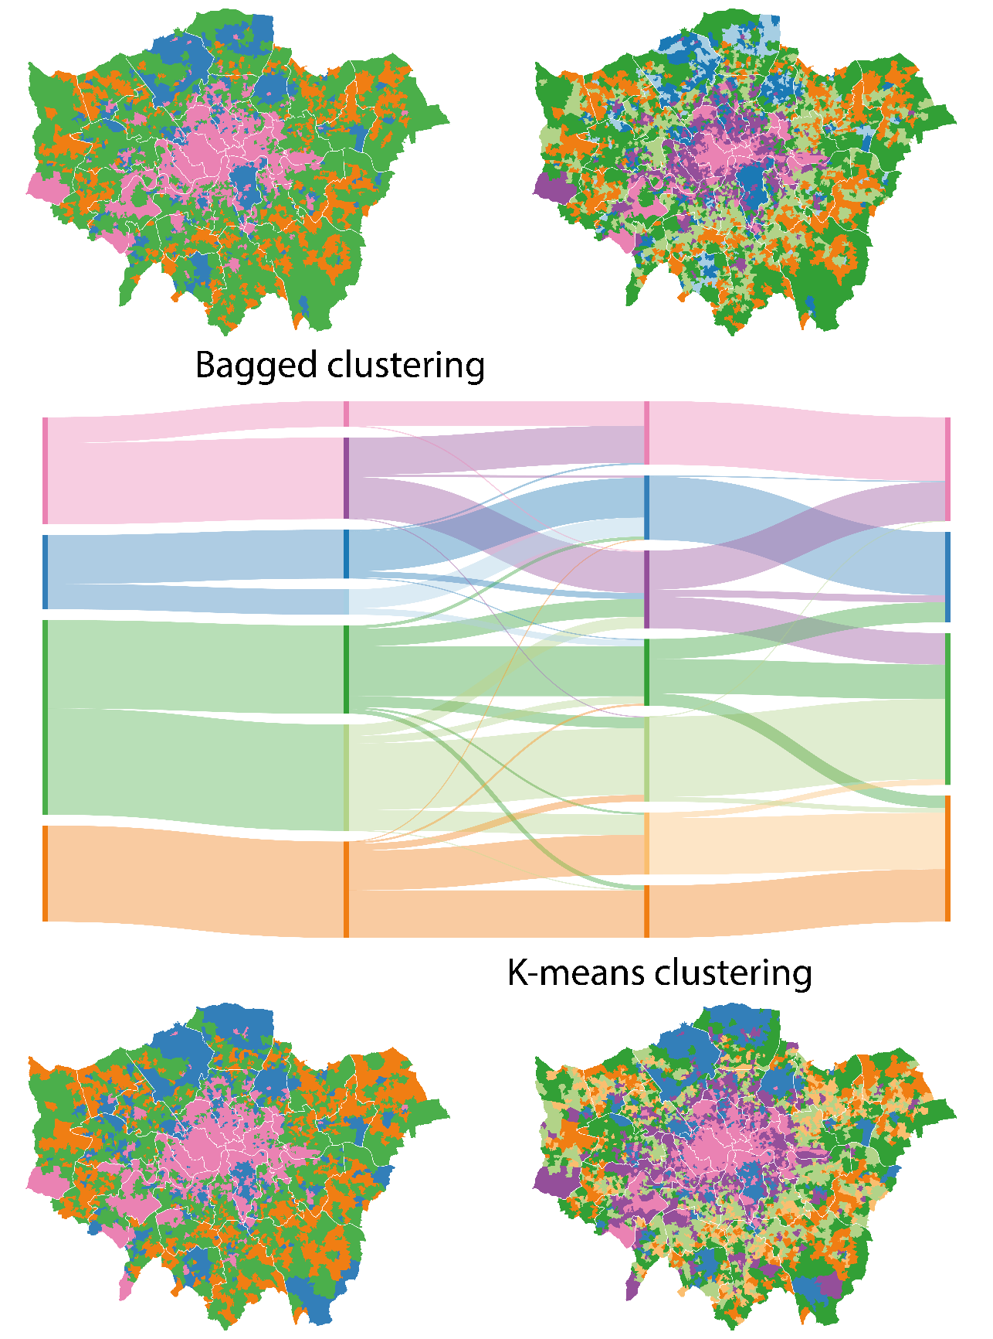
Comparing clustering methods

Slide 36
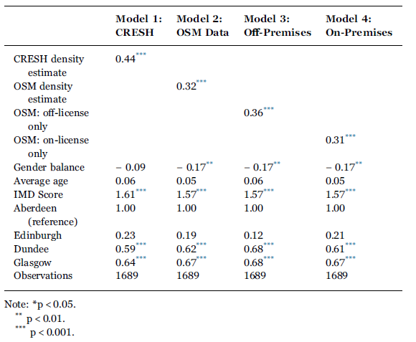
Replication of CRESH study
Notes:
This model illustrates how the number of features in TGN in high coverage countries is of the same order of magnitude as counts in GeoNames, having over 60 (e4.13=62.18) as much content as low coverage countries. Still even in the high coverage group, an increase of 100 features in GeoNames corresponds to an increase of only 71 features in TGN.
The number of features in GeoNames (combined with the dummy variable) accounts for 82% (F(2, 11,152)=0.00026, p b 0.001) of the variation in the number of features in TGN. Similarly to the model above, high coverage cells contain about thirty (e3.40 = 29.96) times as much content as low coverage cells in TGN.

Slide 37
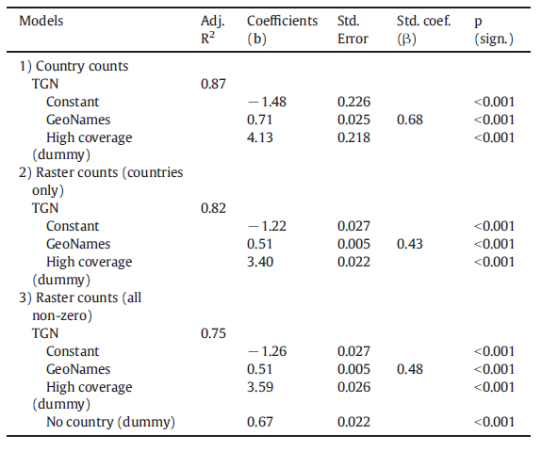
Gazetteers models
Notes:
This model illustrates how the number of features in TGN in high coverage countries is of the same order of magnitude as counts in GeoNames, having over 60 (e4.13=62.18) as much content as low coverage countries. Still even in the high coverage group, an increase of 100 features in GeoNames corresponds to an increase of only 71 features in TGN.
The number of features in GeoNames (combined with the dummy variable) accounts for 82% (F(2, 11,152)=0.00026, p b 0.001) of the variation in the number of features in TGN. Similarly to the model above, high coverage cells contain about thirty (e3.40 = 29.96) times as much content as low coverage cells in TGN.

